Slide 1







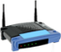




CSC358: Principles of Computer Networks
Lecture 6 – Part 1: IP Addressing
mobile network
4G
national or global ISP
Streaming
video
Skype
IP
local or regional ISP
home network
content
provider
network
HTTP
datacenter
network
Ethernet
TCP
enterprise
network
Erfan Meskar
Winter 2025, University of Toronto, Mississauga

Slide 2
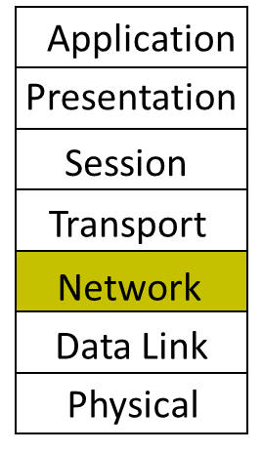
Today
IP Addressing
Subnetting
The IP Packet format
Packet Forwarding
Internet Control Message Protocol (ICMP)
Discovery protocols: ARP and DHCP
Turning names into addresses (DNS)

Slide 3
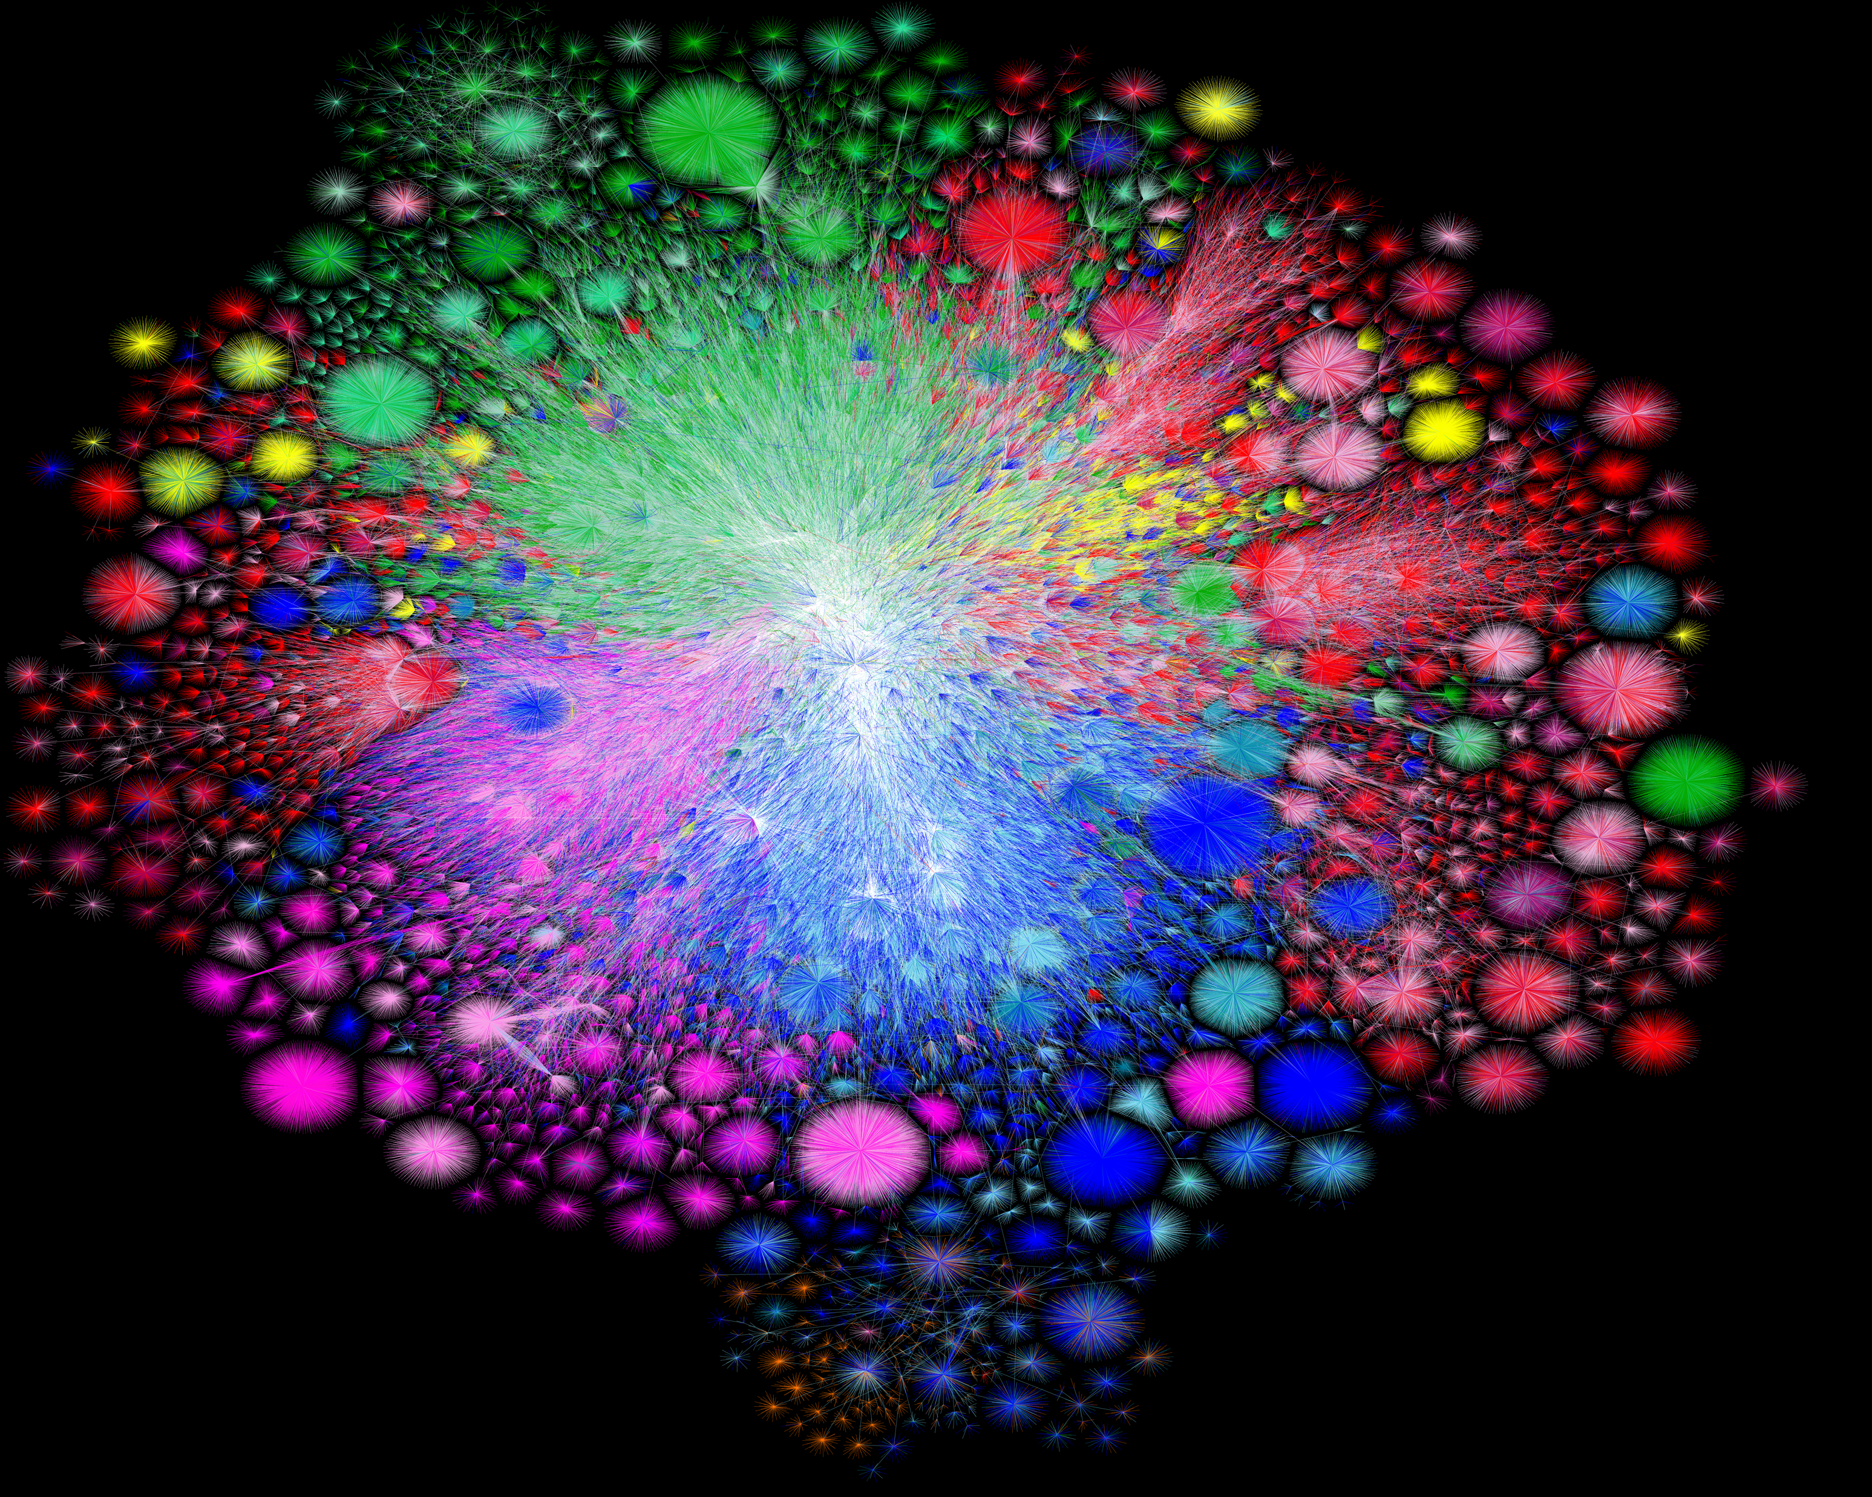
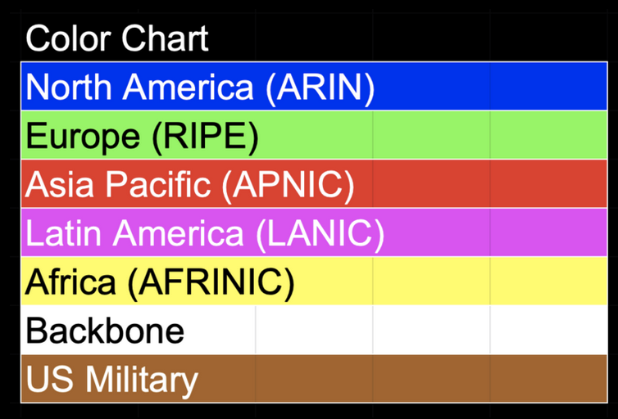
Inter-networking Challenges
This is what the Internet looks like:
Each point is a network, i.e., a group of systems
Internet is a “network of networks”
The goal of the Internet is:
to figure out how to get a message to any point in the graph (i.e., to any network) regardless of
where they are;
whether they’re connected by a copper wire, or a wireless link, etc.;
what’s being sent.
Map of the Internet, 2021 (via BGP), OPTE project

Slide 4
Internet Goals and Design Principles
Thus, Internet was designed based on fundamental principles that ensure universal connectivity, scalability, robustness, flexibility, and openness.
As we discussed, it uses packet switching for efficiency
The End-to-End design principle keeps the network itself simple but moves the intelligence to the edges.
It provides a best effort, connectionless datagram service model
The lowest common denominator among the services required by all
But how does Internet provide universal connectivity?

Slide 5
Universal Connectivity with Internet Protocol (IP)
Universal connectivity is provided by the Internet Protocol (IP)
Everyone uses the same protocol (i.e., Internet Protocol) to their datagram and ask the network devices to deliver it.
Any device with an IP address can communicate with any other device, enabling a truly global network.
Protocol Stack
App
Segment
Transport
TCP / UDP
Data
Hdr
Network
IP
Data
Hdr
Link
IP Datagram

Slide 6
Now, It’s Time to Talk About IP Addresses
Like any protocol, IP has its own packet structure and header fields
This is the IP packet’s format.
32 bits
4 bits
16 bits
version | header length | Type of service (TOS) | Total Length
Identification |  |  | Flags | Fragment offset
Time to Live (TTL) |  | Protocol | Header Checksum
Source IP Address
Destination IP Address
Options (if any)
Payload
Source and destination IP addresses are specified here

Slide 7
Hierarchy Makes IP Different from MAC Address
In LANs we could connect nodes by packet forwarding in data link layer (L2)
We use switches to deliver frames to the destination node
We use MAC address to address nodes
In a global network, we need to route packets in the network layer (L3)
We use routers to deliver datagrams (i.e., IP packet) to the destination to the destination network.
We use IP address to address networks.
MAC address and IP address are fundamentally different
IP addresses have hierarchy, and MAC addresses don’t (i.e., MAC addresses are flat)
switch
router

Slide 8
Why IP address Needs Hierarchy
Suppose hosts had arbitrary IP addresses (like MAC addresses) without any hierarchy
e.g., let’s use arbitrary addresses like 1, 2, 3, …
Then every router would need a lot of information to know how to direct packets toward every host
5
10
9
...
Forwarding Table
1
6
2
host
host
host
IP address | IF/Next hop
1 | IF1
5 | IF2
9 | IF2
…
host
host
...
host
router
LAN 2
IF2
LAN 1
IF1
router
WAN
router

Slide 9
Why IP address Needs Hierarchy, cont’d
If we use hierarchy in our addresses, then forwarding table of the router will be much smaller
Let addresses in LAN 1 start with 1. (e.g., 1.1, 1.2, 1.3, …)
Let addresses in LAN 2 start with 2. (e.g., 2.1, 2.2, 2.3, …)
Then 1.* is on IF1 and 2.* is on IF2
That’s why IP addresses have hierarchy.
2.1
2.2
2.3
host
host
...
host
1.1
1.2
1.3
Forwarding Table
host
host
...
host
router
IP address | IF/Next hop
1.* | IF1
2.* | IF2
LAN 2
IF2
LAN 1
IF1
router
WAN
router

Slide 10
What does an IP Address Look Like?
There are two versions of IP addresses: IPv4 and IPv6.
In this course, we focus on IPv4.
IPv4 (Version 4) addresses are 32 bits (4 bytes) long
We show them with Dotted Decimal Notation, e.g., 128.100.20.20
Each interface (network card) is identified with an IP address
A computer might have two or more IP addresses
A router has many IP addresses
128
100
20
20
10000000
01100100
00010100
00010100
Side note: IPv6 (Version 6) addresses are 128 bits long

Slide 11
Hierarchy in IP Address
IP addresses are hierarchical
They contain a network ID and a host ID e.g., UofT addresses start with 128.100.
A network prefix is the portion of an IP address that identifies the network
Consider the IP address above with the first 24 bits for its network ID.
The network prefix is 130.96.16.0/24
Prefix Length: /24 (which means the first 24 bits are for the network, and the remaining 8 bits are for hosts)
130
96
16
22
10000010
01100000
00010000
00010110
Network (24 bits)
Host (8 bits)

Slide 12
Subnet Mask
A machines IP address alone cannot tell us what is the machine’s network ID.
e.g., consider a machine with IP address 133.100.28.31. What is network ID of this machine?
That’s why we need an additional piece if information to specify network ID.
1 0 0 0 0 1 0 1
0 1 1 0 0 1 0 0
0 0 0 1 1 1 0 0
0 0 0 1 1 1 1 1
Network (16 bits)?
Network (21 bits)?
Network (23 bits)?

Slide 13
Subnet Mask, cont’d
A subnet mask is a 32-bit number that divides an IP address into a network portion and a host portion.
A subnet mask consists of continuous 1s (network part) followed by 0s (host part) in binary form.
A subnet mask paired with an IP address can define the network.
11000000
10101000
00010010
00001111
IP address
AND
11111111
11111111
11111111
00000000
Subnet mask
=
11000000
10101000
00010010
00000000
Network ID
192
168
18
0

Slide 14
Classless Inter-Domain Routing (CIDR) Notation
CIDR notation is a compact way of representing an IP address and its associated subnet mask. It is written as:
IP Address/Prefix Length
e.g., 130.96.19.22/22 means that the first 22 bits are for network ID, and the remaining 10 bits for host ID.
So, subnet mask is 255.255.252.0 (i.e., 11111111 . 11111111 . 11111100 . 00000000)
Thus, the network prefix is 130.96.16.0/22
10000010
01100000
00010011
00010110
IP address
AND
11111111
11111111
11111100
00000000
Subnet mask
=
10000010
01100000
00010000
00000000
Network prefix is 130.96.16.0/22
130
96
16
0

Slide 15
Broadcasting with IP
There are two main types of IP broadcasts
Limited Broadcast (Local Broadcast) with 255.255.255.255 (i.e., all 1s in binary)
A packet with this destination address reaches all devices on the local network.
Note that routers do not forward this type of broadcast. That’s way this packet won’t be forwarded out of the local network.
Directed Broadcast with last address in a subnet (i.e., all host bits set to 1)
E.g.: In a 192.168.1.0/24 network, the broadcast address is 192.168.1.255
Can be forwarded by routers (if allowed) and is used for sending messages to all hosts in a specific subnet.
Note 1: all host bits set to 1 is reserved for broadcasting and cannot be assigned to any device
Note 2: all host bits set to 0 is also reserved to show the network address and cannot be assigned to any device

Slide 16
Knowledge Check
Consider the network 192.168.10.0/26.
What is the number of usable IP addresses to assign to devices in this network?

Slide 17
How Did We End up Using Subnet Mask and CIDR?
How did we end up using this way of IP addressing with subnet mask and CIDR notation?
Back in old days, there was no CIDR!

Slide 18
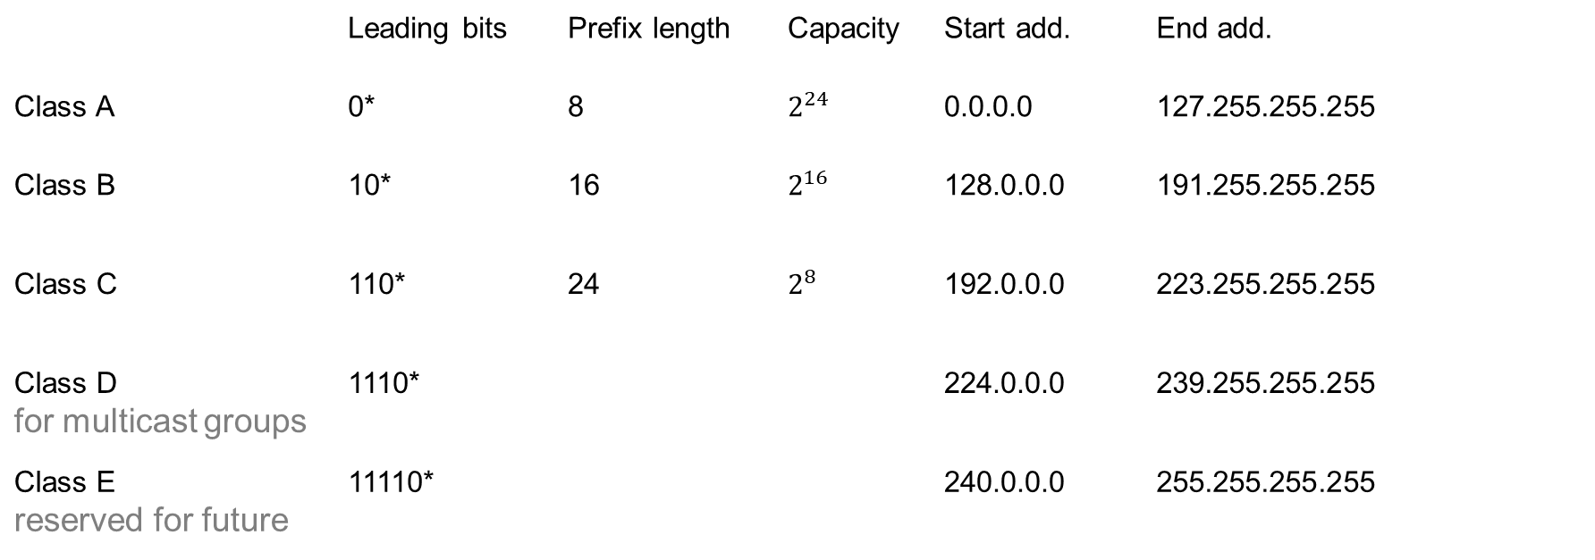
A Bit of History: Class-based Addressing
In old days, hierarchy in IP was implemented without using subnet mask.
There were only 5 fixed prefix classes, each starting with specific bits.
 | Leading bits | Prefix length | Capacity | Start add. | End add.
Class A | 0* | 8 | $2^{24}$ | 0.0.0.0 | 127.255.255.255
Class B | 10* | 16 | $$2^{16}$$ | 128.0.0.0 | 191.255.255.255
Class C | 110* | 24 | $$2^{8}$$ | 192.0.0.0 | 223.255.255.255
Class D for multicast groups | 1110* |  |  | 224.0.0.0 | 239.255.255.255
Class E reserved for future | 11110* |  |  | 240.0.0.0 | 255.255.255.255

Slide 19
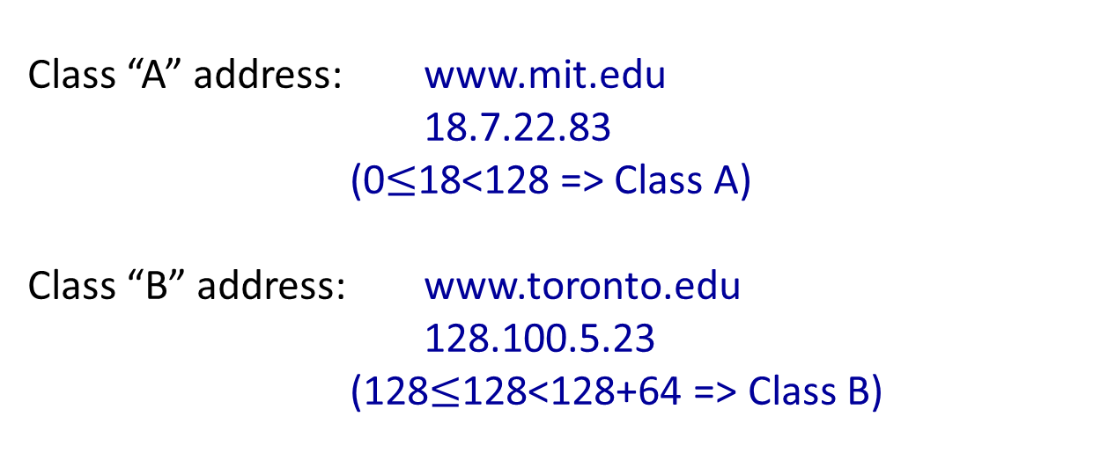
Old Class-based IP Addresses – Examples
Class “A” address: www.mit.edu
18.7.22.83
(0$≤$18<128 => Class A)
Class “B” address: www.toronto.edu
128.100.5.23
(128$≤$128<128+64 => Class B)

Slide 20
Class-based Addressing was Wasteful
Problem:
Address classes were too “rigid”.
For most organizations, Class C were too small and Class B too big.
Led to inefficient use of address space, and a shortage of addresses.
Organizations with internal routers needed to have a separate (Class C) network ID for each link.
And then every other router in the Internet had to know about every network ID in every organization, which led to large address tables.
Small organizations wanted Class B in case they grew to more than 255 hosts. But there were only about 16,000 Class B network IDs.

Slide 21
Subnetting and Classless Inter-Domain Routing (CIDR)
Two solutions were introduced:
Subnetting within an organization to subdivide the organization’s network ID.
Classless Inter-Domain Routing (CIDR) in the Internet backbone was introduced in 1993 to provide more efficient and flexible use of IP address space.
CIDR is also known as “supernetting” because subnetting and CIDR are basically the same idea.

Slide 22
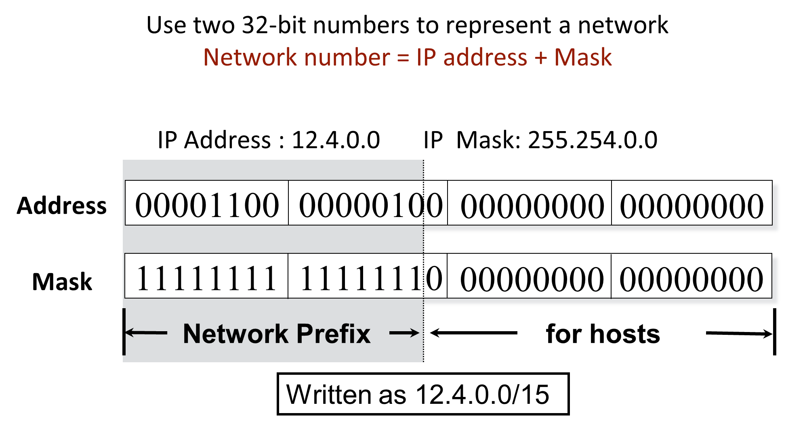
CIDR
With CIDR, we can have network prefixes with arbitrary number of bits

Slide 23
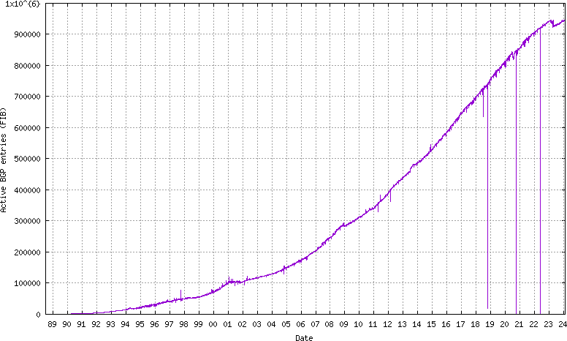
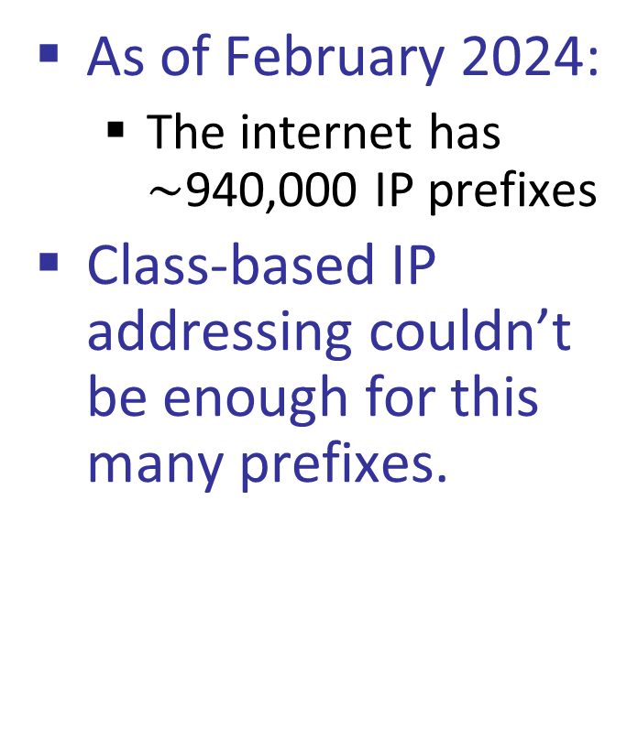
CIDR
As of February 2024:
The internet has $\sim$940,000 IP prefixes
Class-based IP addressing couldn’t be enough for this many prefixes.
https://bgp.potaroo.net/as2.0/bgp-active.html

Slide 24
CIDR Allows Prefix Aggregation
Prefix aggregation:
If a service provider serves two organizations with prefixes, it can (sometimes) aggregate them to form a shorter prefix.
Other routers can refer to this shorter prefix and so reduce the size of their address table.
e.g., ISP serves 128.9.14.0/24 and 128.9.15.0/24, i.e.,
10000000.00001001.00001110.00000000/24 and
10000000.00001001.00001111.00000000/24
it can tell other routers to send to it all packets belonging to the prefix
10000000.00001001.00001110.00000000/23, i.e., 128.9.14.0/23.
ISP Choice:
In principle, maximum prefix length matching, an organization can keep its prefix if it changes service providers. More on this later.

Slide 25

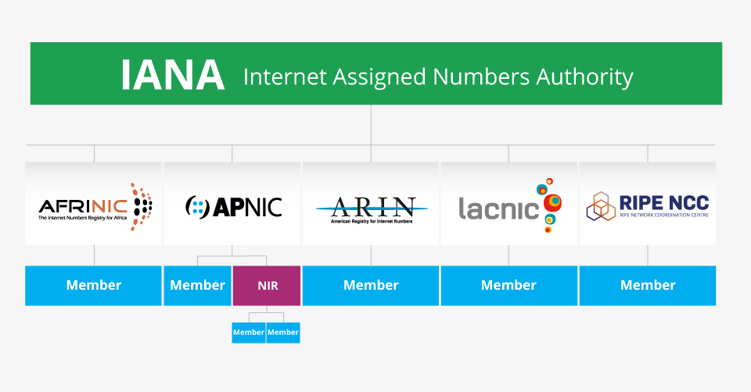
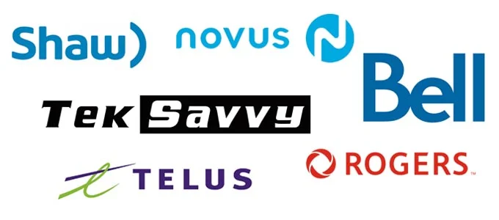
Who Assigns Network Address to Organizations?
Again, there is a hierarchy
Internet Corporation for Assigned Names and Numbers (ICANN)
Allocates large prefixes blocks to Regional Internet Registries (RIRs)
RIRs
RIRs allocates parts of these prefixes blocks to
Internet Service Providers (ISPs) and large institutions

Slide 26
Check Your Interface’s IP Address
On your machines, try
ip addr show or ipconfig /all on windows
wolf:~$ ip addr show dev eth0
2: eth0: <BROADCAST,MULTICAST,UP,LOWER_UP> mtu 1500 qdisc mq state UP group default qlen 1000
link/ether 3c:ec:ef:fb:c0:dc brd ff:ff:ff:ff:ff:ff
altname enp68s0f0
inet 128.100.31.200/24 brd 128.100.31.255 scope global eth0
valid_lft forever preferred_lft forever
inet6 fe80::3eec:efff:fefb:c0dc/64 scope link
valid_lft forever preferred_lft forever
What’s your MAC address? What’s your IP address? What’s your Netmask?

